Slide 1
Effective Scientific Poster Creation & Presentation
EDWIN D. CHARLEBOIS, MPH PHD
Professor of Medicine, Division of Prevention Science

Slide 2
Guidelines for Scientific Poster Design
SUBTITLE GOES HERE

Slide 3
Presenting Your Poster & Networking
SUBTITLE GOES HERE

Slide 4
Goals for Today
To share 30+ years of experience in creating and presenting posters and coaching and guiding poster work by grad students, post-docs, and early career faculty
To provide recommendations and tips for effective scientific poster design and presentation
To point you to useful resources for learning more

Slide 5
Goals for Today
To share 30+ years of experience in creating and presenting posters and coaching and guiding poster work by grad students, post-docs, and early career faculty
To provide recommendations and tips for effective scientific poster design and presentation
To point you to useful resources for learning more

Slide 6
Effective Scientific Poster Creation & Presentation
Topics to be Covered:
Scientific Posters and Early Career Stages
Effective Visual Communication & Adult Learning Styles
Guidelines for Scientific Poster Design
Presenting Your Poster & Networking
Modifications for On-Line and Virtual Presentation
“Concept Poster” Variant
Questions & Discussion

Slide 7
RCC Team—Technical Assistance Expertise
CHRONIC DISEASE AREAS | EXPERTS
Alzheimer’s & Other Dementias | Park, Rhoads
Arthritis | Gansky
Asthma | Cheng, Neilands
Cancer | Rhoads, Gomez, Potter, Khalili, Semere
Chronic Kidney Disease | Ku, Charlebois
Chronic Liver Disease | Khalili
Chronic Pain | Gansky, Yansane
Depression & Other Mental Illness | Mangurian, Neilands
Diabetes | Schillinger, Potter, Semere
Heart Disease and Stroke | Fontil, Schillinger
HIV/AIDS | Charlebois, Rebchook, Brown, Neilands
Hypertension | Fontil, Ku, Charlebois, Ku, Potter, Gansky
Obesity | Schillinger, Cheng, Gomez
Oral Health | Gansky, Banava, Cheng, Spetz, Yansane
Substance Abuse and Addiction Disorders | Brown, Khalili, Spetz, Rebchook, Cheng, Neilands, Gansky

Slide 9
Funding Acknowledgement
Research reported in this presentation was supported by the National Institute On Minority Health And Health Disparities of the National Institutes of Health under Award Number U24MD017250. The content is solely the responsibility of the authors and does not necessarily represent the official views of the National Institutes of Health.

Slide 10
Color Palette

Slide 11
Logos

Slide 12
Font
How to download and install the free font face, Poppins:
1) Open the link below:
Fonts.google.com/specimen/Poppins
2) Click “Download family” in the top right corner
3) Unzip and open the folder
4) Download each font in the folder
5) Re-open the PowerPoint file if necessary

Slide 13
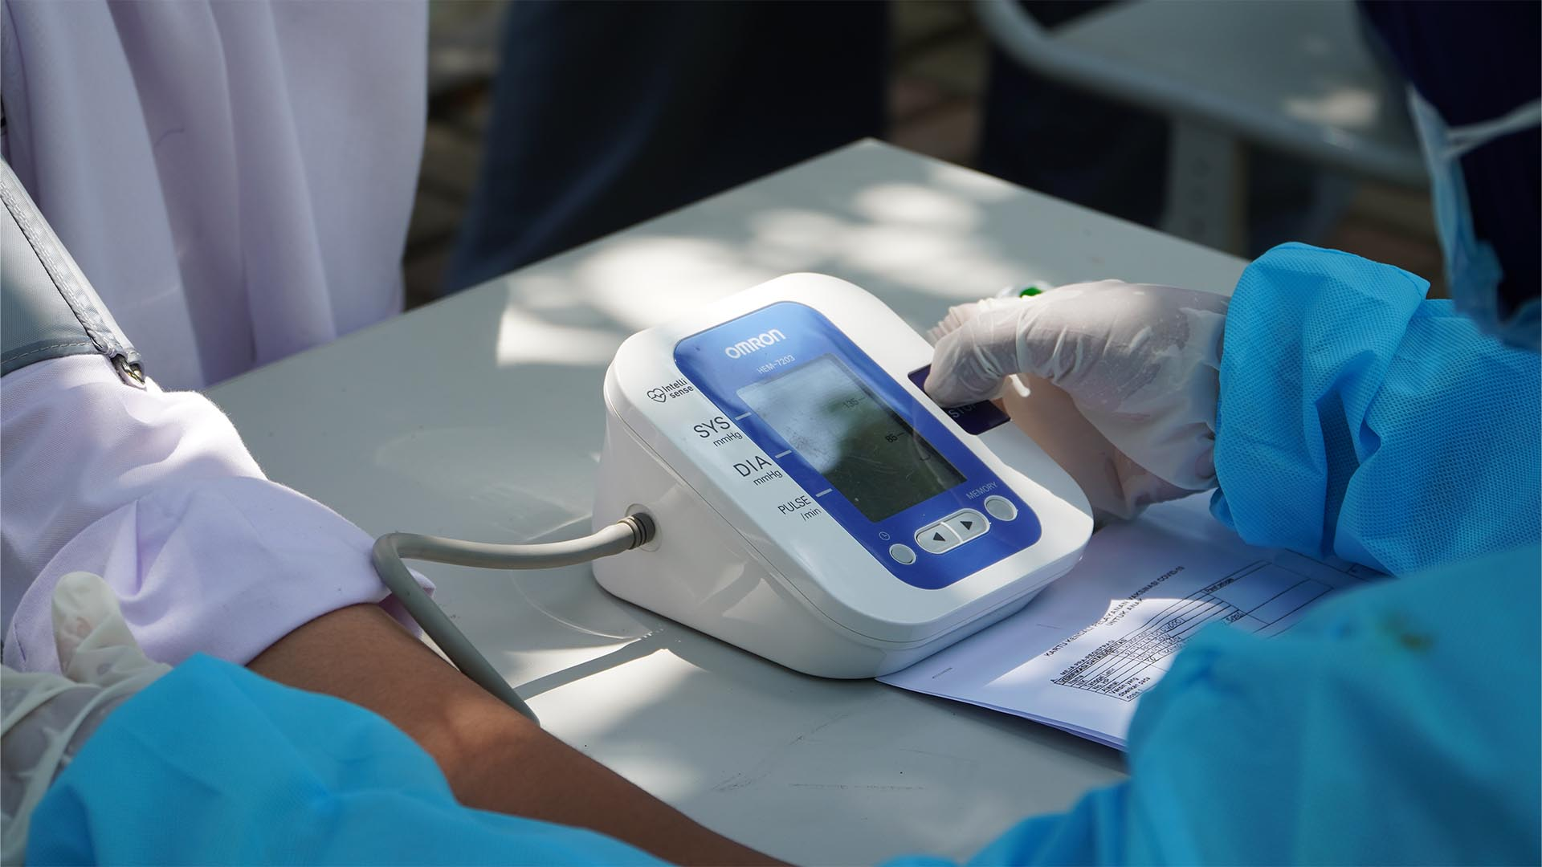
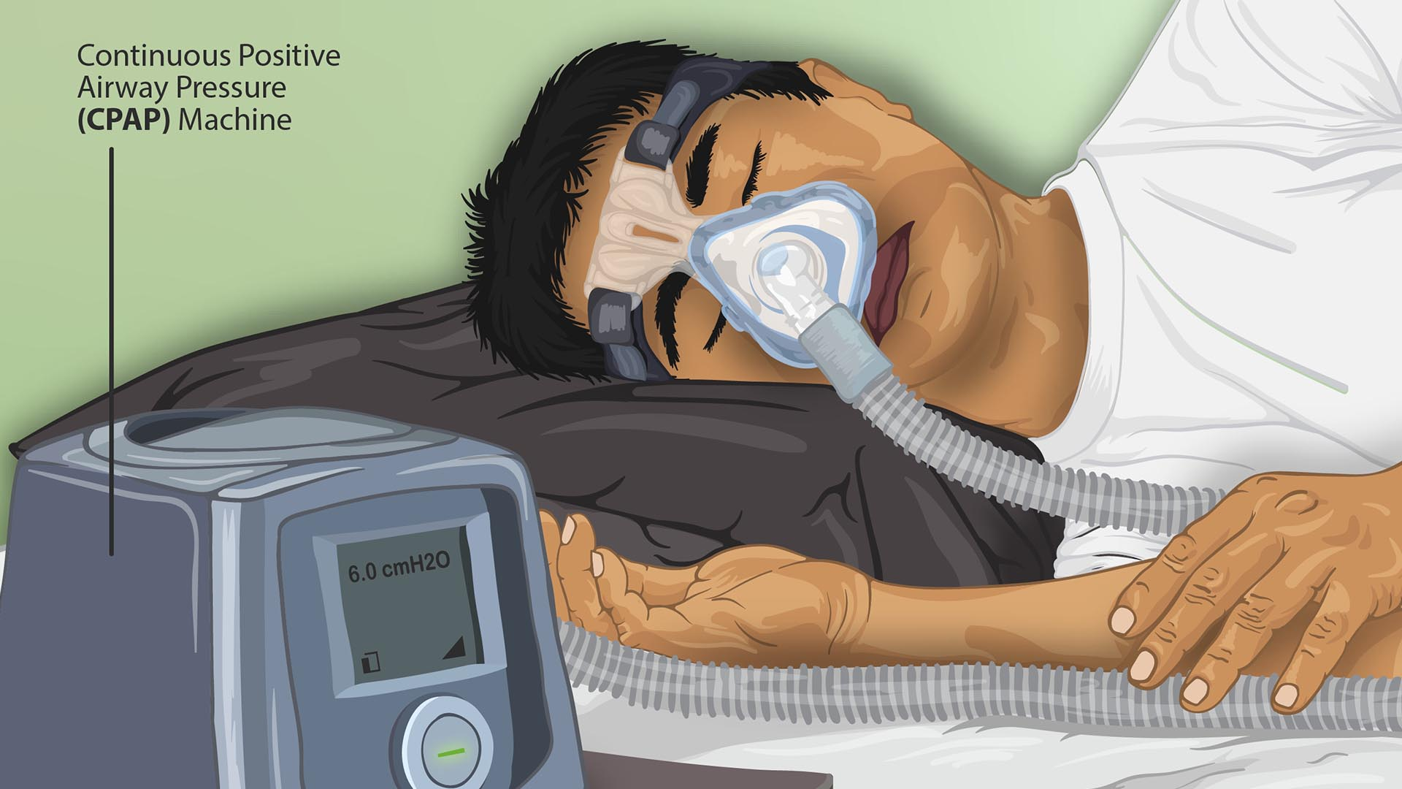
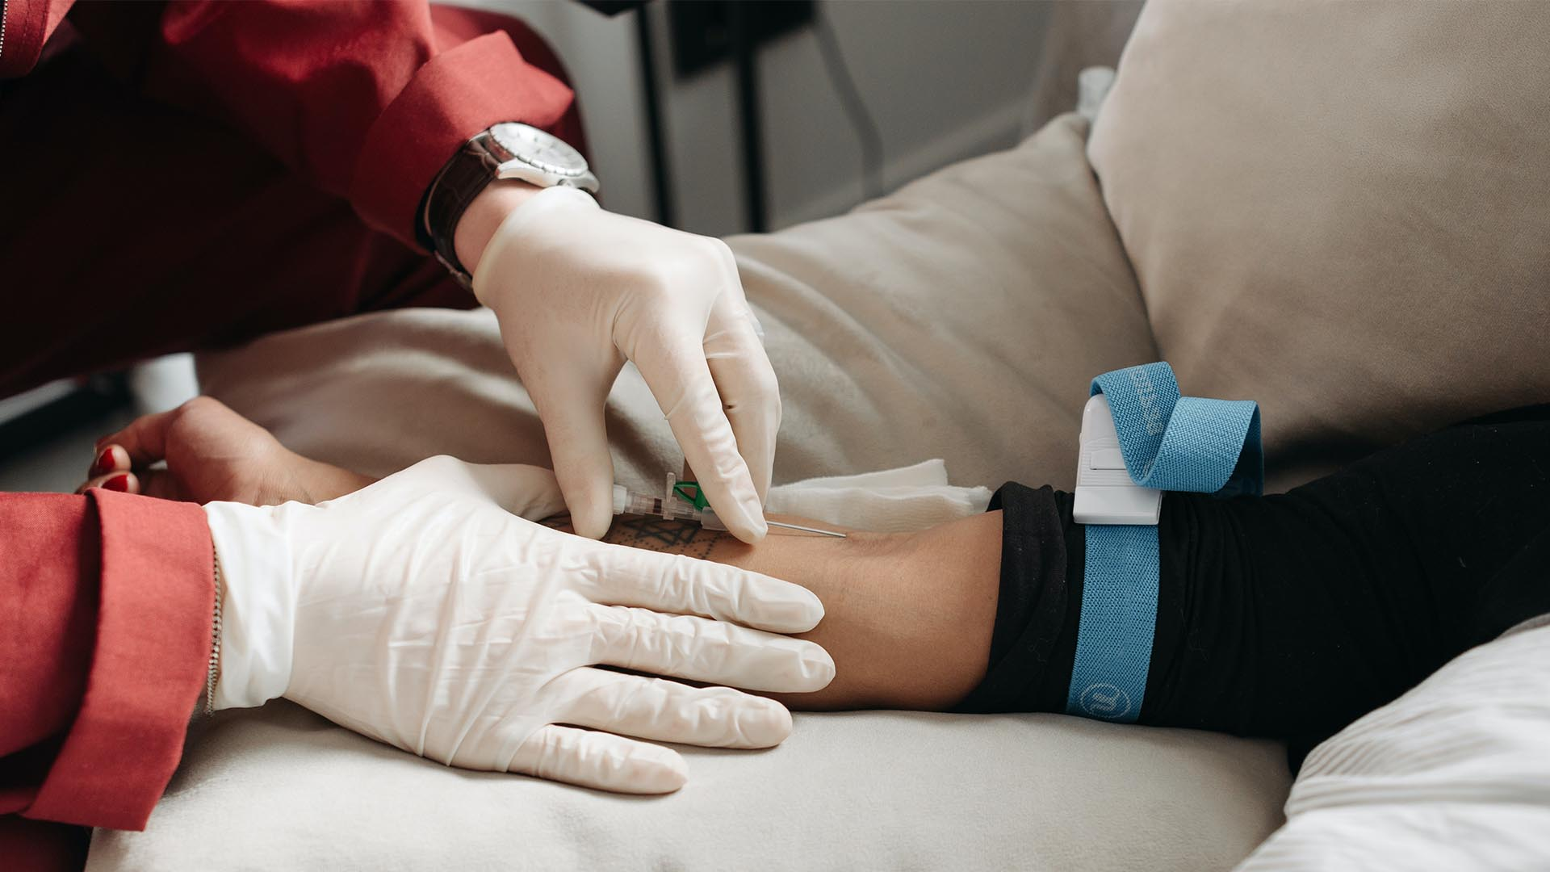
Photos

